Slide 1
Experience Sharing on Web Accessibility
Danny Hui
Senior Manager (Web Development)
Information Services Office
24 October 2014

Slide 2
Why make our website accessible?
It is essential for the University's equality and diversity
It is our social responsibility

Slide 3
Why make our website accessible?
Web accessibility focuses on people with all types of disabilities:
visual
auditory
physical
neurological
cognitive

Slide 4
Why make our website accessible?
Web accessibility also benefits other people…
people with temporary disabilities
elderly
native speakers

Slide 5
Why make our website accessible?
Web accessibility makes websites more compatible with…
mobile devices
new web browsers
older web browsers
browsers with restrictions
low bandwidth connections

Slide 6
Why make our website accessible?
Web accessibility helps to build better websites
consistent design within a website
better usability
easier to navigate
optimized for search engines

Slide 7
Why make our website accessible?
Web accessibility also benefits our team
accessibility guidelines are well established standards for development team to adopt
codes are clean and tidy
easier to be managed by technical staff
easier to be manipulated as templates

Slide 8
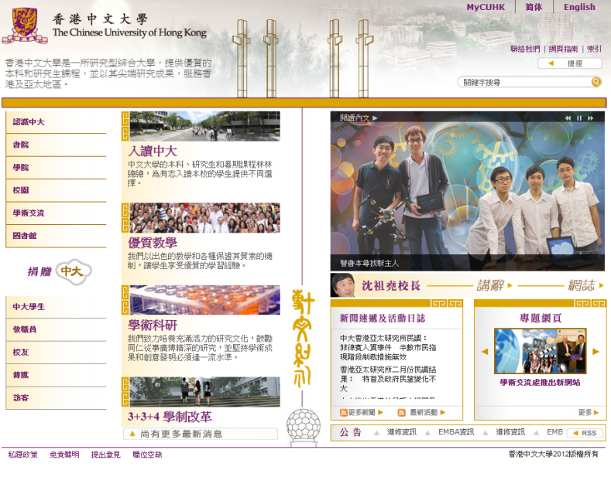
Experience sharing on Web accessibility
CUHK website formally started to include web accessibility in 2009
followed WCAG 1.0 Level AA during a revamp release
effort (or cost) was minimal, because web accessibility helped to build a well-structured website

Slide 9
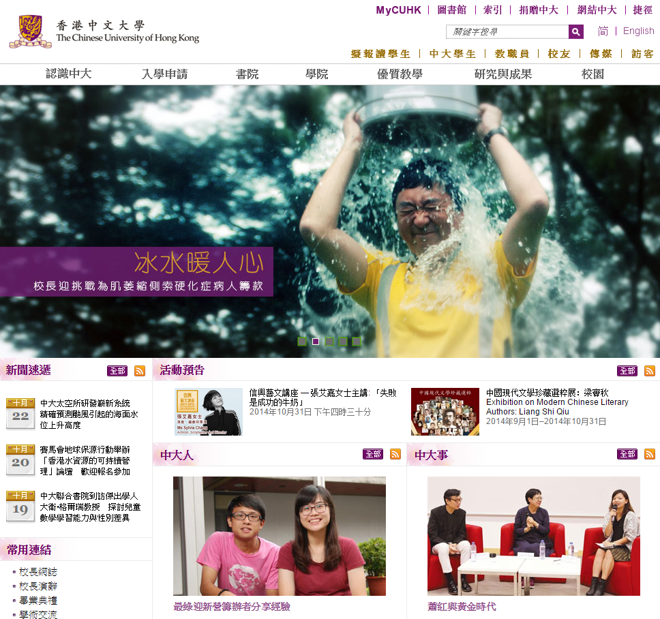
Experience sharing on Web accessibility
CUHK first participated in the Web Accessibility Recognition Scheme in 2012/13
also a revamp release
previous version was web accessible
developers have past experiences
supports from OGCIO in evaluating our website

Slide 10
Experience sharing on Web accessibility
Web accessibility involvement:
Technical
Design
Content

Slide 11
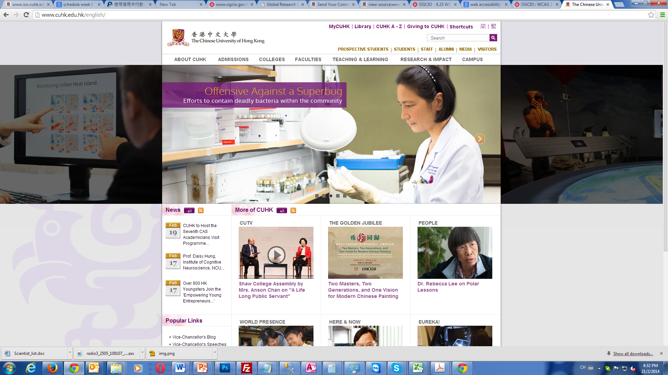
Experience sharing on Web accessibility
Provide sufficient time for users to read the content and operate the function

Slide 12
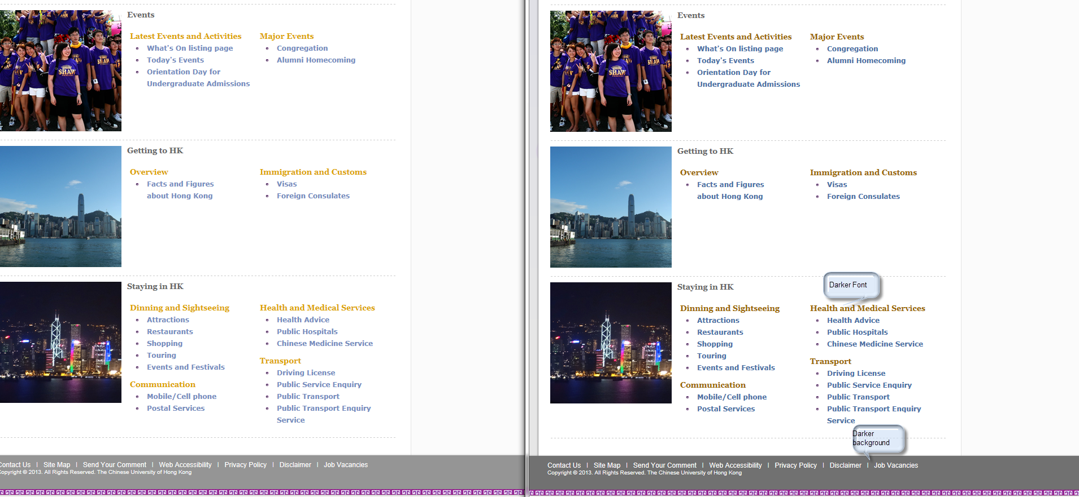
Experience sharing on Web accessibility
Provide sufficient colour contrast
Before
After

Slide 13
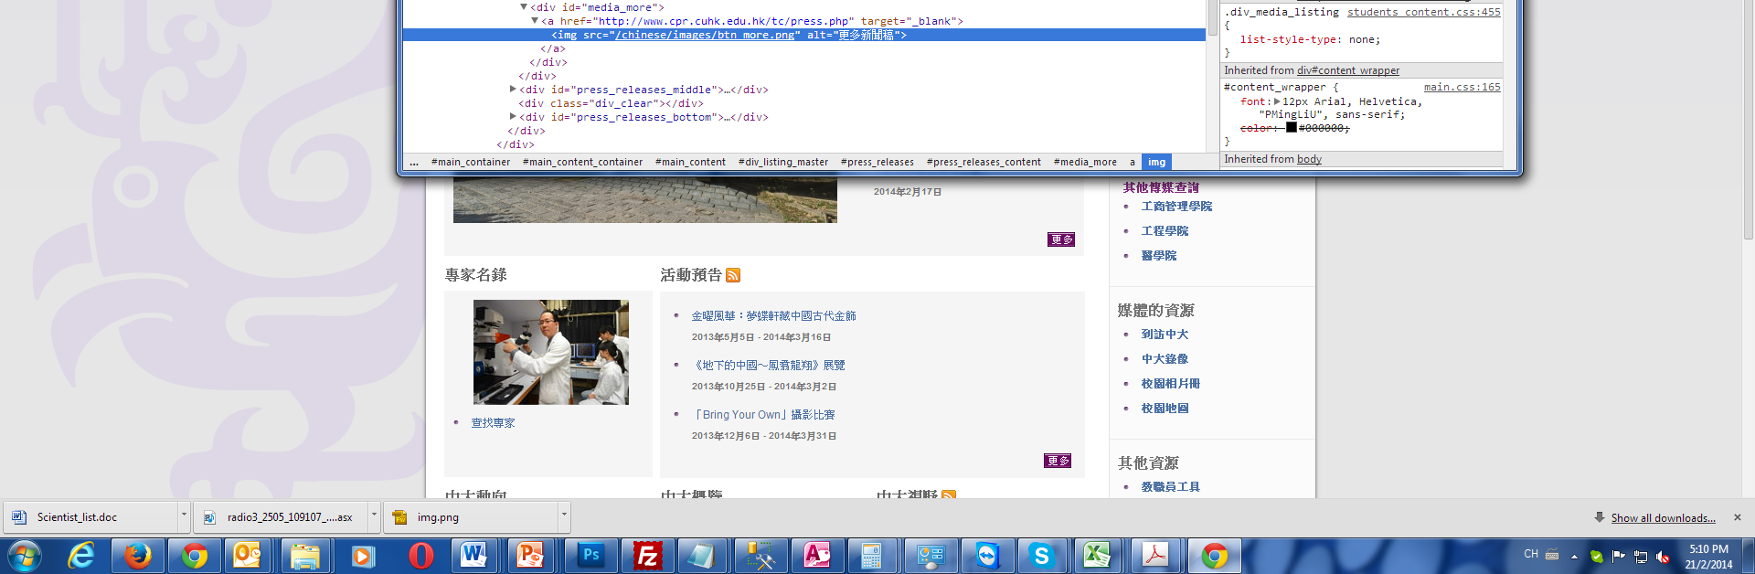
Experience sharing on Web accessibility
Provide clear and informative links
Avoid using “more” e.g. use “more information on enrollment” or “enrollment information”
Avoid using abbreviations e.g. not to use alt=“eng” / alt=“chi”, use “alt=“English version” / alt=“繁體中文版本”

Slide 14
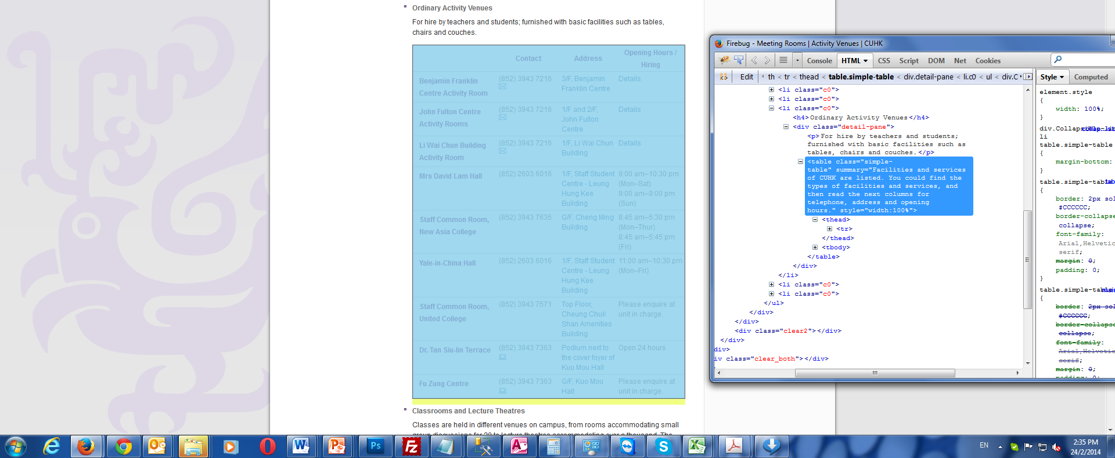
Experience sharing on Web accessibility
Provide meaningful title, summary or description for tables

Slide 15
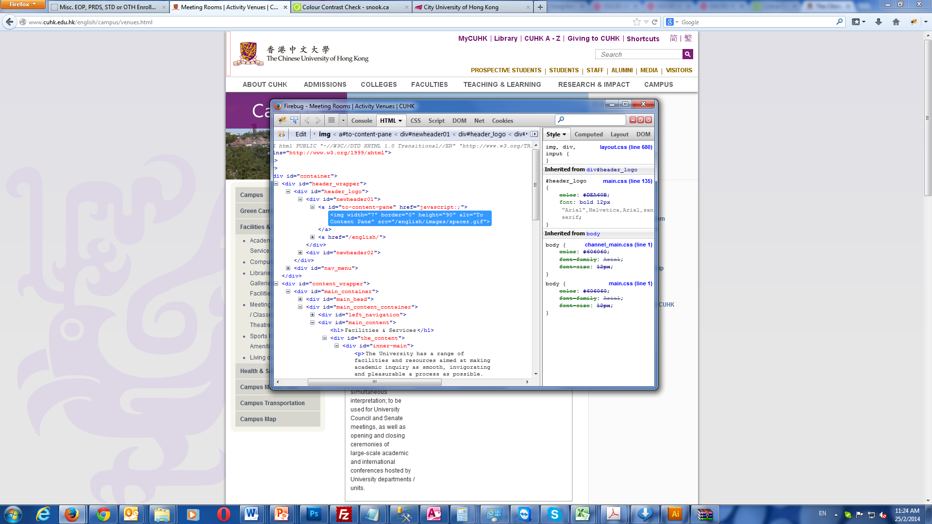
Experience sharing on Web accessibility
Able to skip repetitive blocks

Slide 16
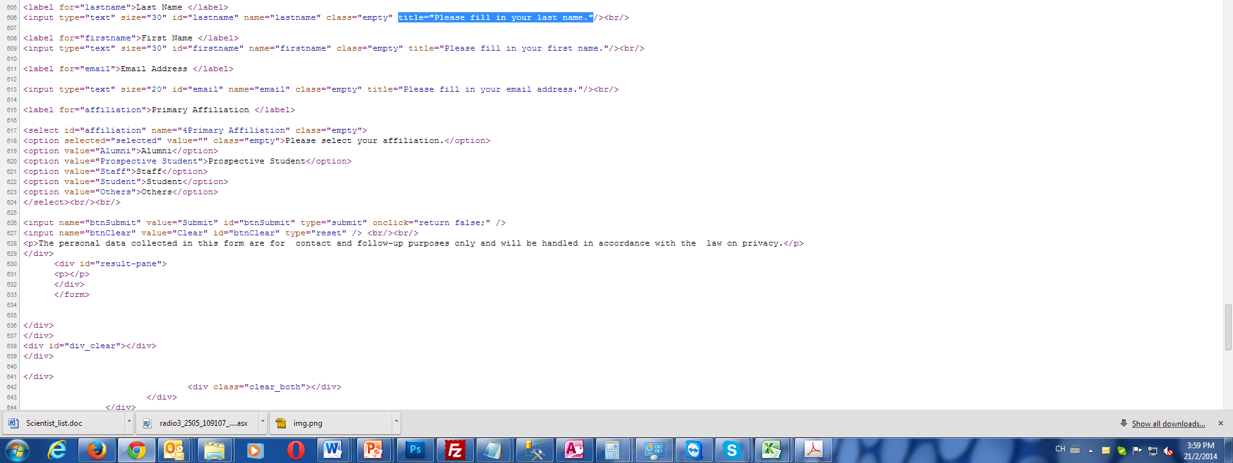
Experience sharing on Web accessibility
Provide input assistance and error identification and description

Slide 17
Conclusion
Web accessibility
is not just the developers’ responsibility
is a continuous improvement process of a website
allows your website to reach a wider range of audience
allows you to build better websites

Slide 18
Thank You

